Slide 1




REVOLUTIONIZING LIVER CARE
PRESENTED BY
Project Presentation
Mohammed Kaif (Team Leader)
Hema Latha
Rama Yugandhar
Rajashekar
ASSOCIATED WITH SMARTINTENZ

Slide 2
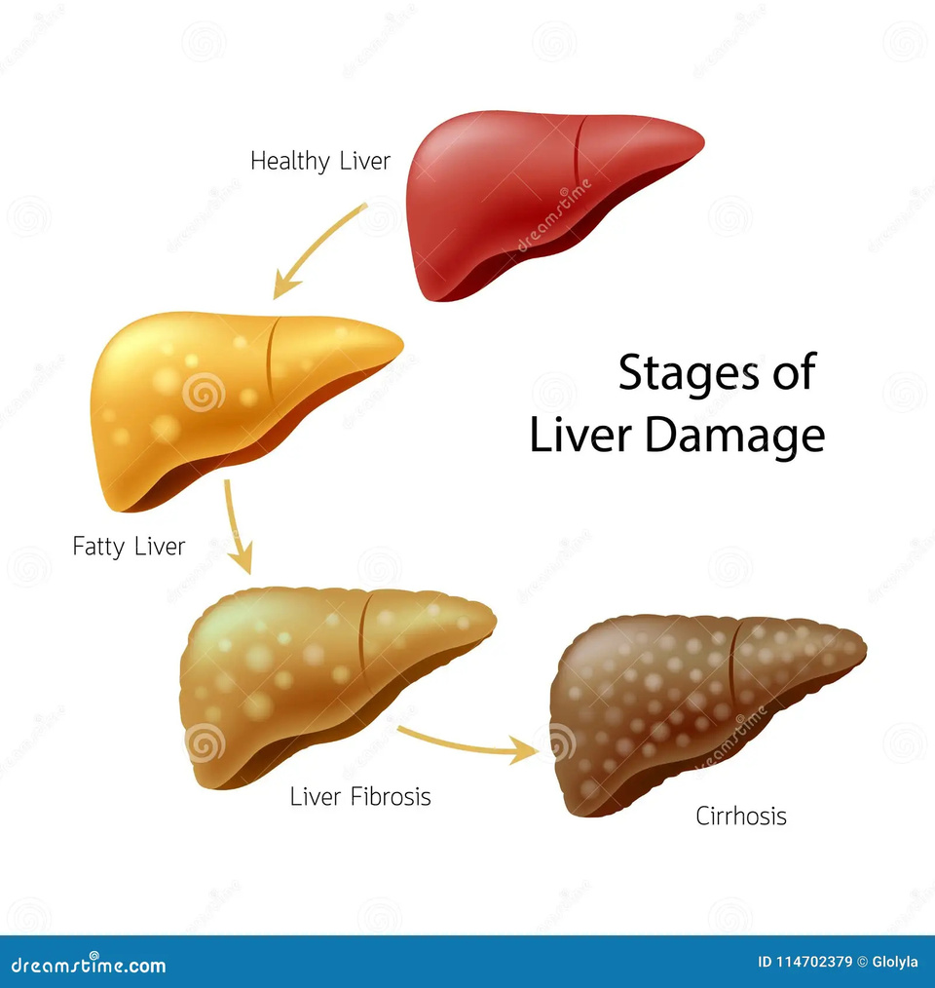
PROBLEM STATEMENT
Cirrhosis is often diagnosed too late.
Manual analysis of clinical data is time-consuming.
Need for a fast, accessible, and interpretable prediction tool.

Slide 3
PROPOSED SOLUTION
INTRODUCING
HepaCheck is a liver cirrhosis prediction tool built using AI.
Users enter clinical data to receive a real-time risk prediction.
Combines machine learning with a simple and accessible web interface.
A Flask-based web app that predicts cirrhosis risk.
Takes 20+ clinical inputs from the user.
Trained Random Forest model gives results instantly.
Visualizes important features for explainability.

Slide 4
SYSTEM ARCHITECTURE
Web App
Form
Scaler
User
Web App
Result
Model

Slide 5
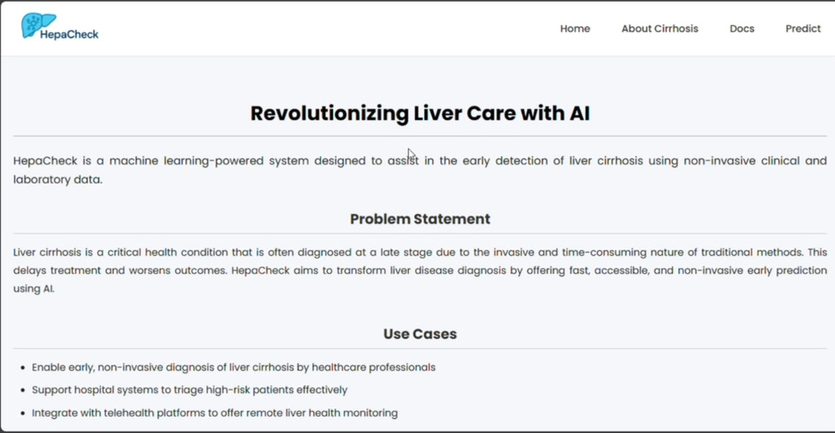
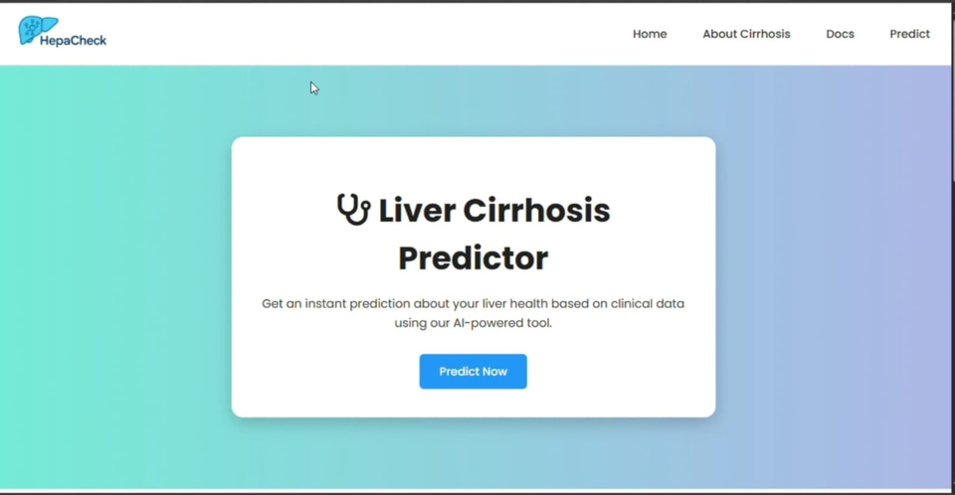
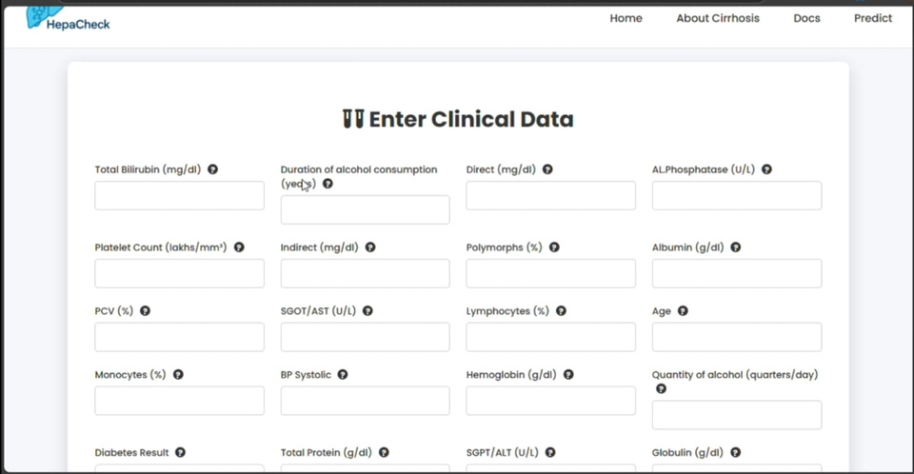
WEB APP
Form with 20 clinical fields
Auto-Fill demo button for quick testing
Real-time prediction with risk message

Slide 6
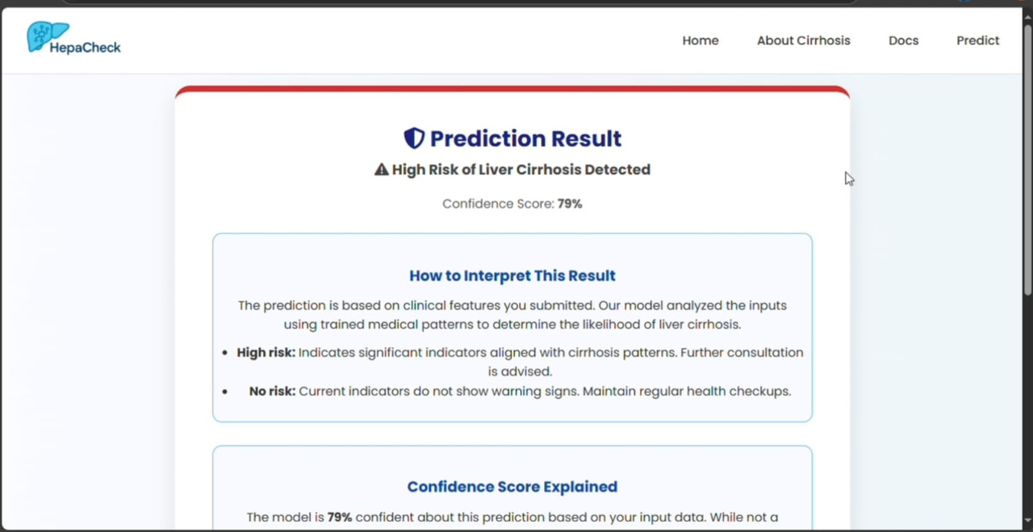
RESULT
Fast, interactive predictions
Model performance: Balanced accuracy with clarity
Simple enough for non-technical users

Slide 7
CONCLUSION & FUTURE SCOPE
Enables early detection of liver issues using clinical data
Fast, interactive predictions
Model performance: Balanced accuracy with clarity
Simple enough for non-technical users
Future Plans:
Doctor feedback loop for retraining
Downloadable PDF reports
Login system for storing patient predictions

Slide 8


LINKS
Live App: https://hepacheck.pythonanywhere.com
Github:
https://github.com/MohammedKaif-3/Liver_Cirrhosis
Dataset:
https://kaggle.com/datasets/liver-cirrhosis
Team Members:
Mohammed Kaif (Team leader)
Hemalatha
Yugandhar
Rajasekhar

Slide 9
THANK
YOU

